Slide 1
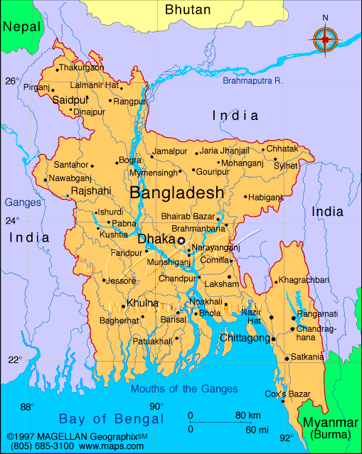
Notes:
Stephanie

Slide 2
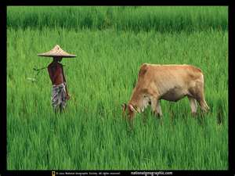

Note. Picture from National Geographic. Retrieved July 12, 2011, from © 1996-2009 National Geographic Society
Note. Picture from Panorama Bangladesh. Retrieved July 12, 2011, from PanoramaBangladesh.com.
Notes:
Stephanie

Slide 3
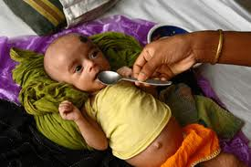
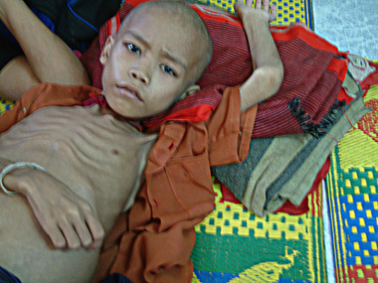

Note. Picture from Save the Children. Retrieved July 12, 2011, from http://www.savethechildren.org.uk/en/hunger_how-we-tackle-hunger.htm
Note. Picture from Sponsor A Child July 12, 2011, from http://www.worldvision.org
Note. Picture from In Defense of Marxism. Retrieved July 12, 2011, from http://www.marxist.com
Notes:
Stephanie

Slide 4

Feed
All of us must join together in this effort, not just because it is right, but because by providing assistance to those countries most in need, we will provide new markets, we will drive the growth of the future that lifts all of us up."
— President Barack Obama
Note. Picture and quote adapted from the Feed The Future. Retrieved July 12, 2004, http://www.feedthefuture.gov
Notes:
Stephanie

Slide 5

How can the ASA make a differnce…
Feed
Running a pilot program called Feed Feed the Future
  We have compiled an offer than will allow you to run the FEED FEED THE FUTURE to benefit Bangladesh
Note. Picture and quote adapted from the Feed The Future. Retrieved July 12, 2004, http://www.feedthefuture.gov
Notes:
Mason

Slide 6
Feed
  Offering an Asian Night of Awareness
  Collaborating with your local Pei Wei and Panda Express
  Having an Ashtray collection
  Student Tuition
  Talking with your student president!
Note. Picture and quote adapted from the Feed The Future. Retrieved July 12, 2004, http://www.feedthefuture.gov
Notes:
Izzy

Slide 7
Feed
Cost
  Expense
  Revenue
  Benefit
  Bangladesh
Notes:
Francisca

Slide 8
Feed
Feed Feed the Future
  Will encourage other colleges and universities
  Everyday people change a life in Bangladesh
  Ultimately forward the UN Millennium Goal
    1. To Eradicate Extreme poverty and Hunger
“The question is not whether we can end hunger, it's whether we will." – Secretary of State Hillary Rodham Clinton
Note. Picture and quote adapted from the Feed The Future. Retrieved July 12, 2004, http://www.feedthefuture.gov
Notes:
Michael

